Slide 1

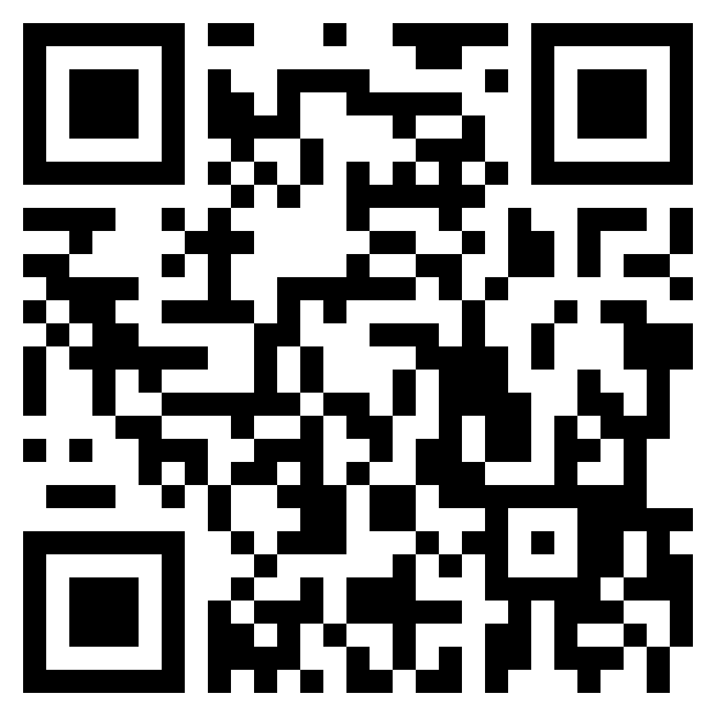
DaBeast Catering LLC
(719) 551-9409
Lunch / Dinner
Cheeseburger ……………………………….…….................... 13.5
With bacon ………………………………………....... Add 1.5
Smoked Chicken Sandwich …………….…............................. 13
Beer Brat ………………………………...................................... 10
Meal deal: Chips and drink …………………………..... Add 3
Pastelillos ………………………………....................................... 5
Stuffed fried empanadas (beef and cheese)
Pincho Fries …....................................................................... 18
Includes smoked chicken, cheese, guava BBQ, & cilantro
Regular Fries …....................................................................... 9
Homestyle Fries ….................................................................. 5
Desserts
Fried Oreos ……………….. 5
Fried Cheesecake Bites …. 7
Limber De Coco (Ice Cream) ………………………………. 5
Beverages
Guanabana ………………. 4.5
Creamy tart drink derived from indigenous fruit ☺
Soft Drinks …………………. 3
Gatorade, Red Bull, Coke, Sprite, Fanta, Iced Tea, etc.
Water ……………………….. 3
https://dabeastservices.com

